Slide 1
電腦視覺與深度學習 (Computer Vision and Deep Learning) Homework 1
TA:
Lydia: lydia2200284@gmail.com
Office Hour: 17:00~19:00, Mon.
10:00~12:00, Wed.
At CSIE 9F Robotics Lab.

Slide 2
Notices (1/2)
Copying homework is strictly prohibited!! Penalty: Grade will be zero for both persons!!
If the code can’t run, you can come to our Lab within one week and show that your programming can work. Otherwise you will get zero!!
Due date =>Midnight 23:59:59 on 2020/11/04 (Wed.)
No delay. If you submit homework after deadline, you will get 0.
Upload to => 140.116.154.1 -> Upload/Homework/Hw1
User ID: cvdl2020 Password: cvdl2020
Format
Filename: Hw1_StudentID_Name_Version.rar
Ex: Hw1_F71234567_林小明_V1.rar
If you want to update your file, you should update your version to be V2, ex: Hw1_F71234567_林小明_V2.rar
Content: project folder*( including the pictures ) *note: remove your “Debug” folder to reduce file size

Slide 3
Notices (2/2)
Python
Python 3.7 (https://www.python.org/downloads/)
opencv-contrib-python (3.4.2.17)
Matplotlib 3.1.1
UI framework: pyqt5 (5.15.1)
C++ (check MFC guide in ftp)
OpenCV 3.3.1 (https://opencv.org/release.html)
Visual Studio 2015 (download from http://www.cc.ncku.edu.tw/download/)
UI framework: MFC

Slide 4
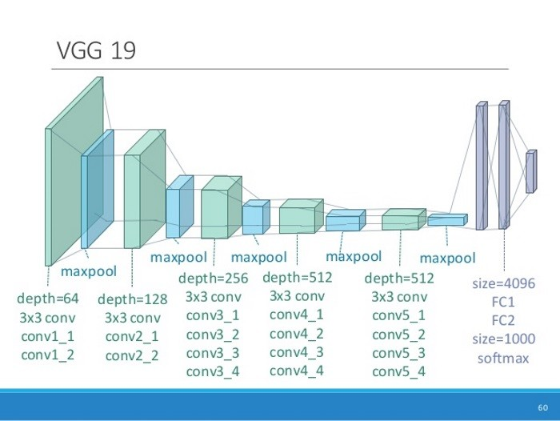
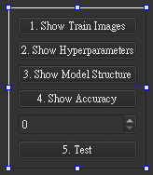
5.0 Training Cifar10 Classifier Using VGG16 (出題：Kevin)
Learn how to construct VGG16 and train it on Cifar10.
Environment Requirement
Python 3.6
Tensorflow 2 / PyTorch 1.3.0
opencv-contrib-python 3.4.2.17 (for image show and write)
Matplotlib 3.1.1 (for chart drawing)
Reference
Very Deep Convolutional Networks for Large-Scale Image Recognition(VGG16)
https://www.cs.toronto.edu/~kriz/cifar.html(Cifar10)
16
input(224x224x3)
input(112x112x64)
flatten
input(56x56x128)
input(28x28x256)
input(14x14x512)
2x2
2x2
2x2
2x2
2x2
10
GUI example
VGG16 framework

Slide 5
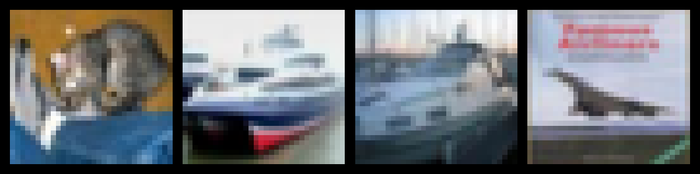

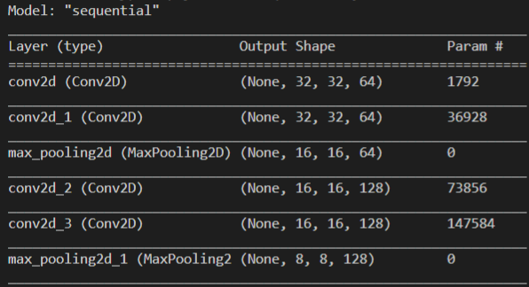
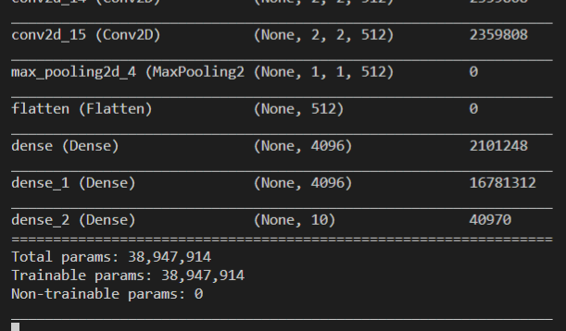
5.1 Load Cifar10 training dataset and randomly show 10 images and labels respectively. (4%)
5.2 Print out training hyperparameters (batch size, learning rate, optimizer). (4%)
5.3 Construct and show your model structure. (Build it your self, do not use architecture provided by ML framework) (4%)
…
Label: cat ship ship airplane …
0 airplane
1 automobile
2 bird
3 cat
4 deer
5 dog
6 frog
7 horse
8 ship
9 truck
…

Slide 6
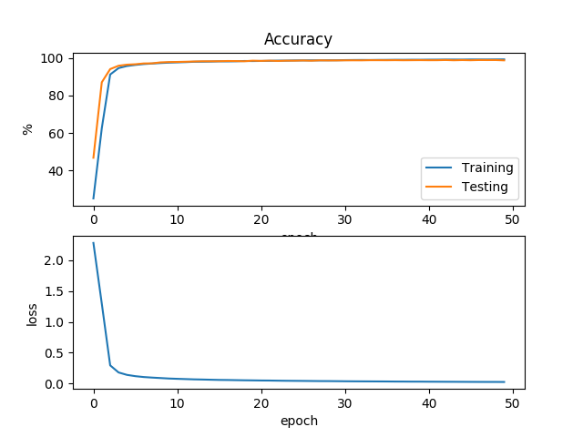

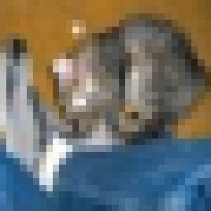
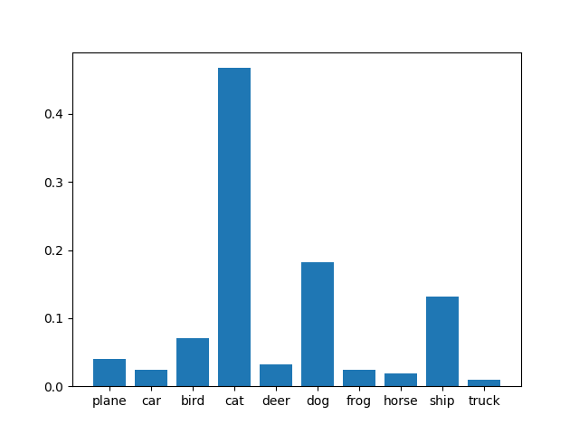
5.4 Training your model at least 20 epochs by your own computer, than save your model and take a screenshot of your training loss and accuracy. No saved images no points (4%) (you only need to show the screenshot image , DO NOT train in homework UI)
5.5 Load your model trained at 5.4, let us choose one image from test images, inference the image, show image and estimate the image as following. No saved model no points (4%)
(record accuracy/loss per epoch)

